Slide 1
Applying the Theory:
HDLC, IP, TCP, SCTP, QUIC
John Day
2024

Slide 2
The Plan
In this lecture, we will look at a few Error and Flow Control Protocols and analyze their designs.
We should expect the analysis to consider what they got right and what they got wrong. The latter will fall into two categories:
  Simply not fitting the design criteria
  Not conforming to the design principles developed earlier.
We will then consider how the same (or better) service could be provided by the Canonical Error and Flow Control Protocol as specified in DIS 4396-9.
  The goal is not to replicate the protocol being analyzed but to provide an equivalent or better service.

Slide 3
HDLC
HDLC (High-level Data Link Control) is an error and flow control protocol for a layer that directly interfaces to the physical media.
The Standard is a collection of mechanisms that can be assembled into variations of the basic protocol to support synchronous/asynchronous, point-to-point/multipoint, etc.
It has the following mechanisms and policies:
  Delimiting: External delimiting, Flag 01111110
  Packing SDUs into PDUs: 1:1
  Ordering/Sequencing: Sequence Numbers, 3 or 8 bits
  Lost and Duplicate Detection: Fixed Sliding Window
  Data Corruption Detection: 16-bit CRC
  Transfer: If there is data, send it
  Flow Control: Fixed Window, 7 or 127 outstanding
  Retransmission Control: Sending Ack advances Window. Retransmit all unack’ed frames on timeout. RNR, RR needed.
  Number of PDU Types: 3, I-frames, S-frames, U-frames

Slide 4
HDLC
HDLC was initiated by IBM submitting its SDLC in 1970 to ISO, but still close to Bi-sync
  French contributions drove development of HDLC, so that
  SDLC is the Sychronous configuration within HDLC.
  As a point-to-point protocol, HDLC could easily be configured to enforce the Watson bounds.
It is distinctly in the data-comm mindset, where special cases are preferred to degenerate cases.
  The static window is clearly an indication that static buffer allocation was intended at the time.
  Using a static window requires the inclusion of the Receiver Not Ready (RNR) and Receiver Ready (RR) commands.
    To handle the case, where a PDU has been successfully received but there is insufficient buffer space to receive more PDUs that would be enabled by Ack’ing the one just received. RNR ack’s the just received PDU the window is advanced, but the sender is blocked. RR unblocks the sender.
    Such commands are unnecessary with a dynamic window.
Over the years, there have been many variations on HDLC and the use of its elements in other protocols, especially the CRC and the bit-stuffing convention for delimiting.
Using Canonical EFCP, while one could do a static window, one would move to a dynamic window, but otherwise it is straightforward. The HDLC frame delimiter and CRC can be used. Other parameters and policies would depend on specific environment, such as propagation time, data rate, etc.
Engineering intuition is often correct: It was often the case that product (and chips) separated the flag and CRC as a separate entity from the rest of the protocol. This is consistent with our observation that they are not actually part of the protocol.
  Even the order is correct, but in different layers.

Slide 5
TCP/UDP/IP
There is so much one could say about TCP/IP and its problems. But we will try to keep it short.
First, its history
  Based on CYCLADES TS, which appeared in 1972.
  First draft of TCP appears for limited review in June 1973, with a more ‘final’ draft in Sept 73 as minutes of the June INWG meeting and a July meeting at Stanford, published in IEEE May 1974 by Cerf and Kahn, first full specification 1975.
  IP split from TCP in 1978. (Breaking fragmentation/reassembly)
  TCP deployed in Jan 1, 1983, which is considerably modified from the 1974 paper.
Unique Characteristics
  Single header format
    Requiring Control Bits rather than PDU types
  Byte sequencing
  Pseudo-header
  Does not separate port-id and connection-endpoint-id
  Use of connection-id to identify application type, no means to specify a specific application.
    This is carried over from the ARPANET NCP
  Stream-oriented API

Slide 6
Early peculiarities
The Problem before them in 1972 was, how to do internetworking.
  Cerf and Kahn had been concentrating on how to do protocol translation at gateways between networks.
    This is very messy and an n² problem to be avoided, if possible.
  First exposed to the concept of datagrams and end-to-end transport, October 1972.
  CYCLADES realized that because they assumed hosts were not to be near network switches (routers), simply re-labeling the Transport Layer, an Internet Transport Layer, an overlay over multiple networks, the messy protocol translation problem is completely avoided.
    The only requirement on the individual networks is to support the minimal requirements of the Transport Layer, i.e., loss due to congestion and rare memory errors during relaying.
      Only requires changing parameters, more address, longer RTT, etc.
    Errors caused by the media are dealt with at the Data Link Layer, as they should be.
  This is the solution to internetworking.
    No mention of it in the Cerf/Kahn 74 paper, only 2-pages on protocol translation. (?)
Kahn strongly pursued finding congestion in the ARPANET (Hafner, 1996; Abbate, 1999)
  And found it, or did he? Never considered congestion with datagrams in the Internet. However, . . .
    Davies pointed it out 1966, and CYCLADES recognized it when they adopted datagrams in 1972 and tasked Waterloo with doing research on it. The Internet didn’t address the issue until 1986, when it collapsed.
  There were deadlocks in the ARPANET, which is what Kahn found
    The ARPANET was basically virtual-circuit so there was no congestion, just a reassembly problem in the front-end.

Slide 7
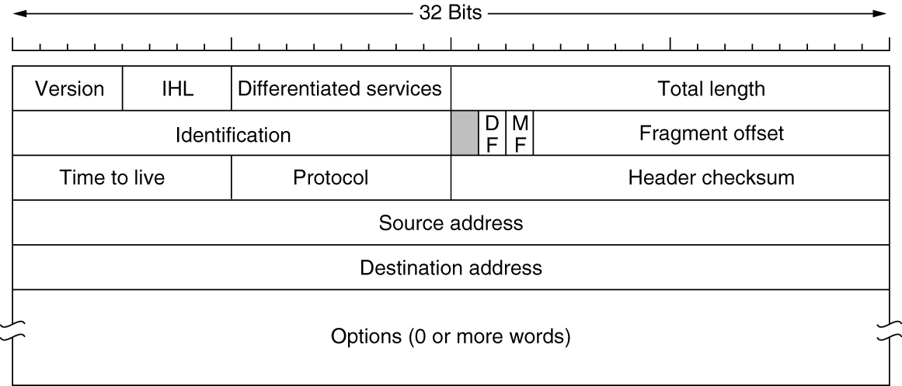
The IP Version 4 Protocol
The IPv4 (Internet Protocol version 4) header

Slide 8
Digression: Why the Protocol-Id field? (1 of 3)
Isn’t this a layer violation?
Yes, that has always been a question. It was clearly necessary, but why?
  In fact, it was the first commentary on the OSI Reference Model, which concluded it was.
If you ask an expert, they will tell you that it identifies the protocol in the User-Data.
  But that can’t be right. It can’t identify more than one occurrence of the same protocol.
  It only identifies what kind it is, but why?
When we were working on making the Application Layer recursive,
  We found that ACSE (to create application connections) needed to identify the syntax of the Data Transfer Phase. In Application Layer terms, it needed to specify the Presentation-Context.
  THAT was what the Protocol-Id field was doing: identifying the syntax of the User-Data.
That answers What it does, but not Why is it needed?
  Other protocols don’t need it.
  Hint: IP (and Ethernet MAC) don’t have a connection-id, i.e., port-ids.
    Of course not, they’re connectionless!!

Slide 9
Digression: Why the Protocol-Id Field? (2 of 3)
Note: These protocols don’t have port-ids because they don’t have an Allocation Phase.
Of course not, they’re connectionless!!
  The zealousness of the convert. Always more pure than the original.
Are they a separate Layer? Yes.
Are the addresses part of IP? Yes.
Then how does the Transport Layer tell the IP Layer where to send the PDU?
  Because addresses are exposed at the layer boundary.
    The Application makes the mapping from application-name to network-address.
But that is a security vulernability. Yes.
There is no Allocation Phase?

Slide 10
Digression: Why the Protocol-Id Field? (3 of 3)
There is no Allocation Phase?
  Right! It is connectionless!
  The only way to create a UDP flow is manually. It can’t be done from a process?
  Well, errrr, not until fairly recently.
What does Allocation have to do with connection or connectionless?
  Well, nothing really.
If there is Allocation, then IP can be folded into the data transfer protocol, simplifying the code and reducing PCI overhead 25%.
  But you eliminated IP! Yea, interesting, isn’t it? ;-)
And eliminates the protocol-id registration authority, fewer is always better.
  But don’t you have to add CEP-ids? one for every destination!
  No, the (N)-layer will create one flow per destination per QoS class. Fields already exist for that.
  Some Layers might want a few sub-classes within a QoS-class (priority within the class). Those would require perhaps a one-byte field.
Notes:
Or a nibble, divide the QoS-cube-id in half. (It is local to the layer anyway.)

Slide 11
IPv6 Changes (from RFC 8200)
Expanded Addressing Capabilities
  IPv6 increases the IP address size from 32 bits to 128 bits, to support more levels of addressing hierarchy, a much greater number of addressable nodes, and simpler autoconfiguration of addresses. The scalability of multicast routing is improved by adding a "scope" field to multicast addresses. And a new type of address called an "anycast address" is defined; it is used to send a packet to any one of a group of nodes.
    With larger addresses, it has become far more complex, various kinds of addresses, but can’t define what their scope is. Some routers can only route on the first 64 bits. Multicast still is a mess with the flawed definition. Still debating how ‘anycast’ works.
Header Format Simplification
  Some IPv4 header fields have been dropped or made optional, to reduce the common-case processing cost of packet handling and to limit the bandwidth cost of the IPv6 header.
    True, but it has led to more complex processing. Router is using the first 192 or 384 bytes to make forwarding decision.
Improved Support for Extensions and Options
  Changes in the way IP header options are encoded allows for more efficient forwarding, less stringent limits on the length of options, and greater flexibility for introducing new options in the future. 40% of packets with Hop-by-Hop Headers being dropped.
Flow Labeling Capability
  A new capability is added to enable the labeling of sequences of packets that the sender requests to be treated in the network as a single flow.
    Still some debate on its use. Highly likely when it is used, there will be Extension Headers.
Authentication and Privacy Capabilities
  Extensions to support authentication, data integrity, and (optional) data confidentiality are specified for IPv6.
  IPsec same as IPv4

Slide 12
IP Version 6 (from Tanenbaum)
(the spin doctor version)
IPv6 major goals
  Support billions of hosts
  Reduce routing table size (only realized after choosing the design)
  Simplify the protocol (then why all the RFCs?)
  Provide better security (hype, same as IPv4)
  Attention to type of service (still debated and not clear)
  Aid multicasting (same flawed definition, and more complex)
  Roaming host without changing address (then it isn’t an address)
  Allow future protocol evolution (design thwarts that, they mean Extension Headers which are worse.)
  Permit coexistence of old and new protocols for years
    (Yes! The only field in common with IPv4 is the version field)

Slide 13
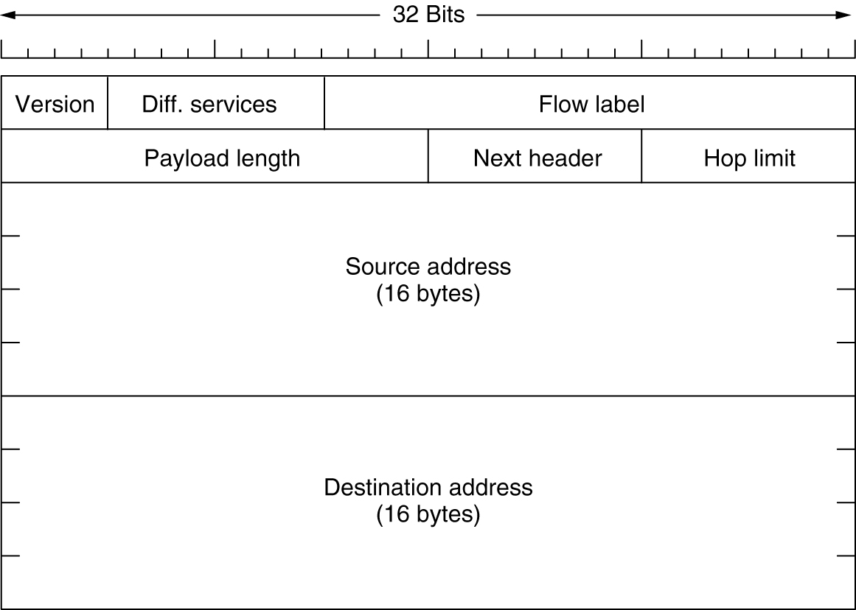
The Main IPv6 Header
The IPv6 fixed header (required)
Notes:
Notice the commonality with IPv4. ;-)

Slide 14
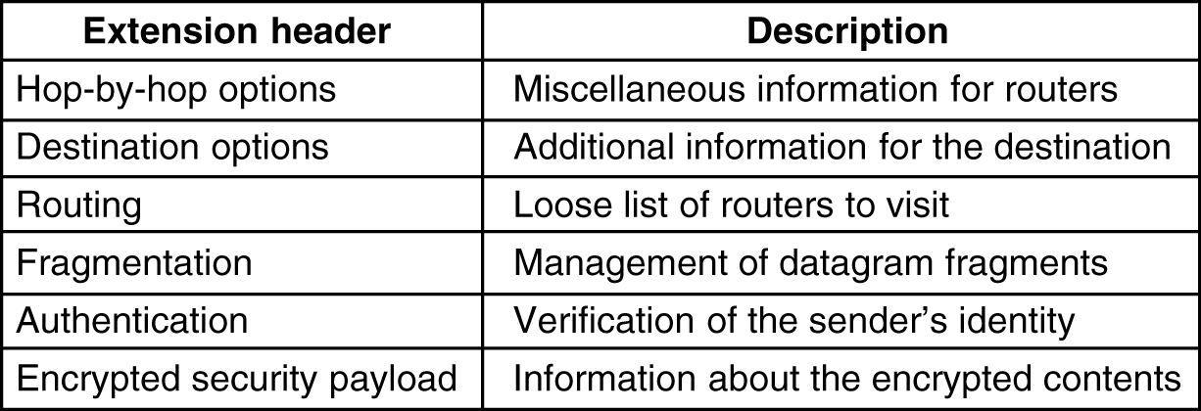
Extension Headers
5-69
IPv6 extension headers.

Slide 15
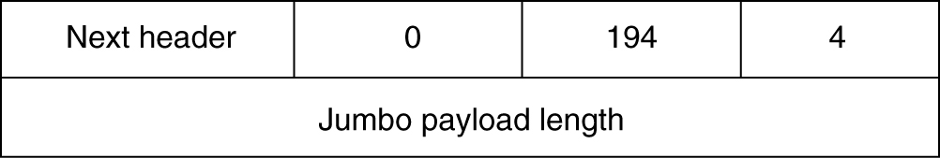
Extension Headers (2)
The hop-by-hop extension header for large datagrams (jumbograms).
Notes:
Remember there is no Protocol-Id field? It is just the last option. Kewl!! A degenerate case! Just what I have been emphasizing!
No, Idiots! There are now two lists of assigned numbers for the same field. The IPv6 options field and the Protocol-id field!

Slide 16
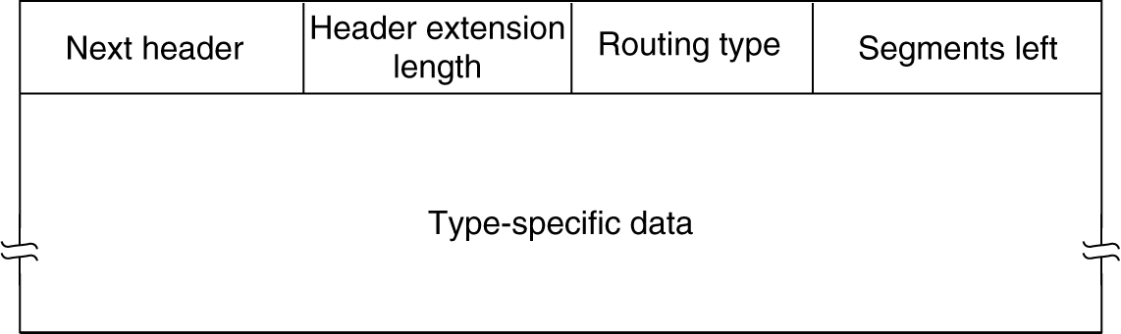
Extension Headers (3)
The extension header for routing.

Slide 17
IPv6 Problems: I
The Biggest Problem is that it Still Names the Interface.
  No multihoming, very complex mobility, requires using more addresses.
Many more addresses.
  True, but only suppose to route on /64. Luckily some go further, others don’t.
  Some believe Lower 64 suppose to be a flat ‘endpoint-identifier’ and globally unique
    Names everything twice address is only 64-bits, not 128.
  This gets worse and worse.
Using MAC Address (EUI-64) in the lower 64 is a security hole.
    (We have known since the early 80s that this was not a good idea.)
  Nothing like putting your identity in every packet! NSA must love that!
  Good news! This has been deprecated, but some still do it.
  But never recognized that this was what makes the address route-dependent.
    If the idea is used, it will make multihoming and mobility more complex.
Header Simplification - Gee whiz! 2% of the problem.
  Extension Header processing more than makes up for it.
  Protocol-id field is now the last option. Hey! They did a degenerate case! Thinking!
    Oops! Two assigned number registries for the same field.
© John Day, All Rights Reserved, 2020
Notes:
Conflicting definitions of the scope of different kinds of v6 addresses.
Conflicting problems with the use of options.
Fragmentation only done by hosts. Requires MTU discovery, which doesn’t work.
Plug n Play isn’t as plug and play as v4.
Concept of scope of an address is broken and they don’t know how to fix it.

Slide 18
IPv6 Problems: II
Six (!) kinds of Extension Headers (EH), TLV encoded, and can’t be skipped.
  Hop-by-Hop
  Fragmentation
  Destination
  Routing
  Authentication
  Encapsulation Security Payload
While it is recommended that EHs occur in this order, it is not required.
  Remember this is one of the “improvements”
Currently 40% of PDUs with Hop-by-Hop options are dropped.
Fragmentation is only done by the source. (Then why is it needed?)
    The Packet-Id is 32-bits and the offset is 13-bits.
  Fragmentation Still Doesn’t Work (Well, we knew that. How could it?)
  Interaction of EH and Fragmentation
    What happens if the options won’t fit in the first fragment? (no one knows)
Segment Routing is using the Routing EH to define the source route with a list of IPv6 addresses.
  How much room is left for data!?
Typical Router will move the first 192 or 384 bytes to faster memory for processing. (!)

Slide 19
IPv6 Problems: III
MTU Discovery is mandatory, but doesn’t work
  Not completely useless: Heartbleed made good use of it!
Will Routing Scale to 4.3 billion IPv4 address spaces?
  It barely works for one!
Improved security - same as IPv4
    Ground rule: Anything developed before transition must work with both.
    Ironically, IPv6 is better for DDoS attacks because most of the IPv4 space is in use. Highly likely a fake source address is going to generate a reset.
Does not address the real problem: Router table size – Last heard > 1 Million
Transition requires a NAT - Once you have a NAT, you don’t need v6
The real problem with adoption - No benefit to whomever pays for the transition.
No private addresses - Had to reverse themselves on this. (twice)
    Much to their chagrin this one of the big points for v6!
There are going to be scaling problems: Route calculation.
Know we have left some out.
Consequently, IETF has resorted to spin.

Slide 20
What is Going on Here?
When one reads the IPv6 RFCs, one gets an impression of ‘whackamole.’
  Things added incrementally as thought of.
  There are several hundred IPv6 RFCs. (!)
There is no real overall architecture that they are building to.
  Defined several kinds of IPv6 addresses but can’t define their scope.
  A simple question about anycast was typical: led to discussion citing many different RFCs.
What should be done?
  First IP was a mistake as we have seen from the structure of data transfer protocols, they naturally cleave between control and data.
  All flows must be flow controlled, all layers that relay must have congestion or contention management
    Get rid of UDP; run flow control wide open but keep means to shut it down if necessary.
  Likely that 128-bit addresses are unnecessary. 32, 48, or 64 should be sufficient.
    Forwarding decision can be made based on Address, QoS-cube-id, and maybe a CEP-id but not usually.
      Less than 10 bytes
  No options, all such information should be distributed by layer management.
    Recognizing that source routing is equivalent to virtual circuit.
  Orders of magnitude simpler.

Slide 21
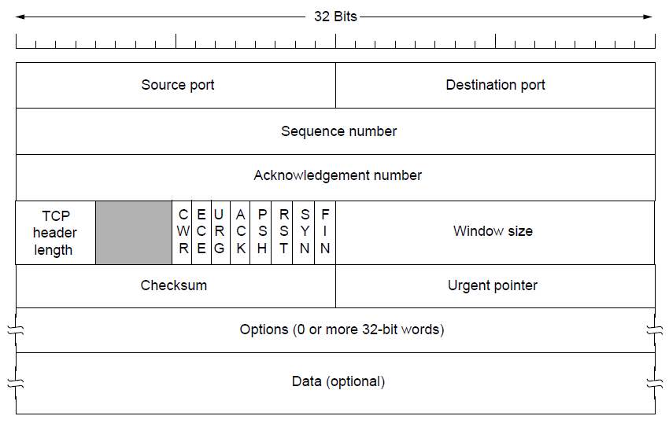
The TCP Header
The TCP header.
Notes:
Congestion Window Reduced
Explicit Congestion Notification
Urgent is being used for X-windows resize events.
The argument for the single header and piggybacking acks is that it was more efficient. This was because of Tenex and it is as long as lots of packets have less data than the header.

Slide 22
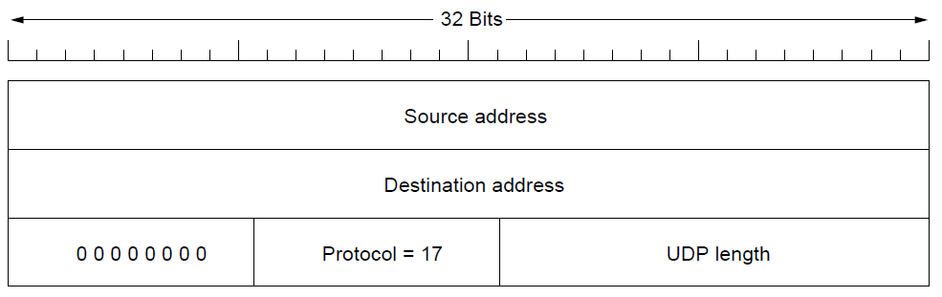
TCP/UDP Pseudo-Header
Or 6 for TCP
TCP or UDP
header length
The IPv4 pseudo-header included in the UDP checksum.
And TCP checksum!
Notes:
I don’t know why this is here. The pseudo-header pre-dates UDP and was done for TCP.

Slide 23
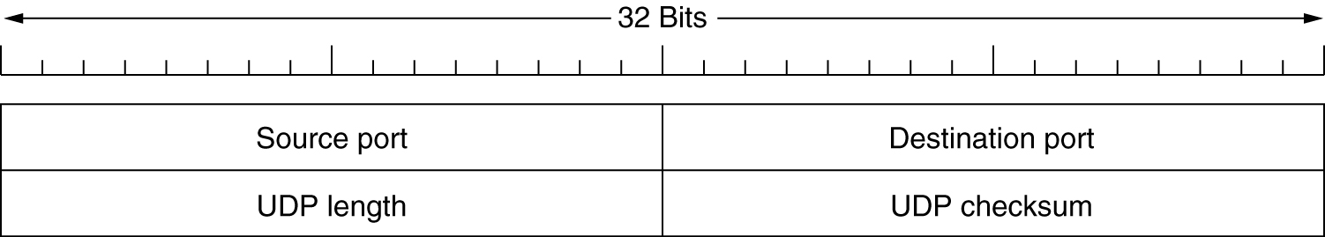
Introduction to UDP
The UDP header.
(In the Model, we have developed this more or less corresponds to the tightly-coupled mechanisms half of the Error and Flow Control Protocols)
UDP should be deprecated. It is a DoS security threat.
There should be no flows in a network that are not flow controlled.
Notes:
Just a note. Why we won’t cover so called real time transport protocols here: They are Application Protocols.
To have more than one UDP flow we need port-ids. This should be deprecated.

Slide 24
The TCP Service Model
Port
Protocol
Use
21
FTP
File transfer
23
Telnet
Remote login
25
SMTP
E-mail
69
TFTP
Trivial File Transfer Protocol
79
Finger
Lookup info about a user
80
HTTP
World Wide Web
110
POP-3
Remote e-mail access
119
NNTP
USENET news
Some assigned ports.
Overloading the Connection-Id
A kludge becomes institutionalized.

Slide 25
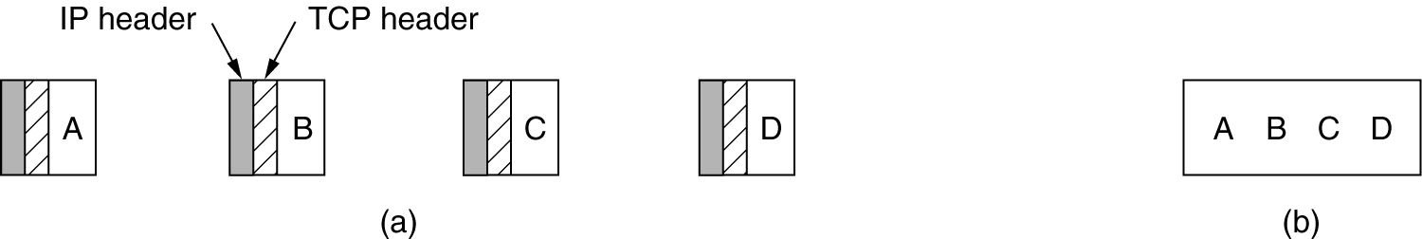
The TCP Service Model (2)
(a) Four 512-byte segments sent as separate IP datagrams.
(b) The 2048 bytes of data delivered to the application in a single READ CALL.
Notes:
Stream. Turns out this is not what most applications want.
Notice that reassembly argues for statically allocated buffers.

Slide 26
Problems with TCP: I
We have already covered that the Sockets API is poor design.
  Requires applications to be modified to use the network.
    Delayed Microsoft support of IPv6 by 2 years.
  IOW, the application must know whether or not the requested application is local or remote.
  It exposes too much of the internal workings of the layer.
Overloading connection-id and well-known ports leads to security holes
Combining port allocation and synchronization makes security harder.
Lesson: Overloading functions always creates problems.
  If there are devils is in the details, there is something wrong with the design
The pseudo-header was a mistake.
  The standard rationale was that it was protection against mis-delivery of a PDU.
  How that was supposed to occur has never been explained.
  The pseudo-header is a major barrier to supporting mobility.
Stream-mode was also a mistake.
  Most applications prefer SDUs, and it makes good software-engineering sense.
© John Day, All Rights Reserved, 2022
Notes:
Of the 4 or 5 protocols proposed at the time, this is easily the worst.

Slide 27
Problems with TCP: II
Primary design consideration was for very small PDUs (< 5 bytes) for terminal traffic.
  The rationale for piggybacking Acks, byte sequencing, but contradicted by large PCI.
  Not forward looking. Was obsolete by 1990.
Single header format runs counter to the inherent structure of these protocols,
  Which naturally cleaves between data transfer and feedback control.
    With separate PDUs, the data transfer overhead is 50% less.
  Considerable PCI overhead (40 bytes with IP). Complicates implementation.
    Traffic peak at 40 bytes (SYNs and Acks) indicates Acks are treated as a separate PDU type.
  And makes separating mechanism and policy cumbersome.
Control bits vs PDU types was a bad idea. Now treated as a PDU type.
  But complicates implementation. Need to mark fields that are good.
Piggybacking acks was a major design feature.
  No advantage unless data is less than length of PCI. (terminal traffic)
  By 100 bytes of data, any efficiency advantage is lost.
  Most traffic isn’t that symmetrical. Need to optimize its use further complicates the implementation.
© John Day, All Rights Reserved, 2022
Notes:
Of the 4 or 5 protocols proposed at the time, this is easily the worst.

Slide 28
Problems with TCP: III
Byte sequencing was not a good idea.
  The first objection and most severe is that sequence number space rolls over too soon, leading to the Timestamp option being necessary for virtually all connections.
    This problem was raised in the mid-70s. Making sequence number larger would have made the PCI even longer which was already too long for the data rates of the time.
      Increasing it requires 2 field be longer: Sequence Number and Ack
  Three rationales have been given:
    It makes fragmentation at gateways easy. (original, a good one)
    To facilitate flow control on terminal traffic. (after IP was doing gateway fragmentation)
    Fine granularity flow control (after IP was doing gateway fragmentation)
  These are not good for the following reasons:
    When Fragmentation at Gateways was moved to IP, this should have become packet sequencing.
    The last two don’t make sense. Set the MTU for the connection to an appropriate value and any granularity of flow control is possible.
    Because retransmission is not on the same byte boundaries, re-assembly is unnecessarily complex. (see next sequence of slides).
  Max MTU should be a property of the layer, so fragmentation at gateways is unnecessary. (MTU on individual connections may be less than Max MTU.)
© John Day, All Rights Reserved, 2022
Notes:
The reason for not retransmitting on the same byte boundaries was again for terminal traffic. In the meantime, more characters could be accumulated when there was a re-transmission and it would be more efficient .. . (until it got to the other end).
Of the 4 or 5 protocols proposed at the time, this is easily the worst.

Slide 29
“If It Ain’t One Damn Thing
It’s Another!”
-Aristophanes*
The Birds, 414 BC
TCP adopted byte sequencing for fragmentation at the gateways between networks. (Before IP is separated from TCP.)
  The byte number of the first byte of data is the sequence number of the packet, the sequence number of the next packet is sequence of the first + length +1
  When the packet is fragmented, the byte number of the first byte of data becomes its sequence number of the fragment. Simple! Really pretty elegant.
  This avoids having another field (Fragment Offset and a More Fragment bit) to identify fragments that isn’t always needed, if there is no fragmentation en route.
    In 1974, this idea was worth checking out.
  However, even then there was concern that sequence numbers would roll-over too quickly.
    Today, majority of TCP connections must use the Extended Sequence Number Option.
*Obviously, a modern translation. ;-)
Never thought I would find a use for it!

Slide 30
One Thing Leads to Another: II
When IP was separated from TCP, IP used a 16 bit Identifier (per packets), a Fragment Offset, and a More Fragment bit.
  This is the solution TCP didn’t use.
  The Packet Identifier can repeat fairly quickly
  IP doesn’t retransmit, so Fragmentation doesn’t work and never has.
TCP retained byte sequencing, even though it wasn’t needed at the gateways.
  The ‘rationale’ became, it was needed for finer grain flow control.
    If the Maximum Packet Size for the connection is known.
      TCP requires it in the first packet
    Any granularity can be accommodated with Packet Sequence numbers.
    And a larger Sequence Number field (and Ack field) are not required.

Slide 31
One Thing Leads to Another: III
But TCP packets can arrive out of order, so reassembly is necessary.
  The simple thing would be to use a doubly linked list kept in sequence number order.
  When out of order packets arrive, insert the new packet after the sequence number less than the new packet and before the sequence number greater than the next packet here.
But . . . Suppose it is lost . . . .
Reassembly
Queue
300
400
600
700
Seq #
Seq #
Seq #
Seq #
Length
Length
Length
Length

Slide 32
One Thing Leads to Another: IV
Packet 400
Packet 700
Packet 475
TCP is not required to retransmit on the same byte boundaries.
  That means that one could get Packet 400 and 600 and
  Then Packet 500 is lost and retransmitted as Packet 475.
Reassembling this in a doubly linked list is going to be very complicated!
  Packet 475 would have to be truncated on both ends and a new packet created.
  The retransmissions could generate any of the possible combinations.
O, but there is an easy solution!
  Instead of a doubly linked list, lets use a circle-q!

Slide 33
One Thing Leads to Another: V
475
300
400
700
Current
Head of Q
Current
Tail of Q
A Circle Q would make it really easy
  Allocate a contiguous block of memory with pointers for the head and tail, wraps around as packets are removed from the head and added at the tail.
  When Packet 475 arrives, simply start writing it in the circle-q at byte 475 overwriting the parts already received and filling in the parts that were missing! Simple.
That would work really well and be very simple.
Errr, not so fast. There is a problem.
This is static allocation of buffers to connections

Slide 34
On Thing Leads to Another: VI
Static Allocation Takes Oceans More Resources!
Pooled vs Static Buffers
From Denning, Peter. “A Statistical Model for Console Behavior in Multiuser Computers” CACM, Vol.11, No.9 p.605, Sept 1968.
For 50 users and a ratio of characters/interrupt = 10.
This result is completely general for static vs pooled resources. It is really a no-brainer: Always pool buffers, unless there is a good reason to ensure it will run out.
  Takes at least 6 times more memory for static vs pooled and it isn’t linear.
  At today’s requirements the difference will be measured in orders of magnitude.
Total Buffer Size Probability of Overflow
(in bytes) Pooled Static
750 .006 .90
1000 10⁻⁶ .76
1500 .44
2000 .22
2500 .10
3000 .05
3500 .02
4000 .01
4500 .004
Blank because the numbers were too small to be represented by the computer.
It takes to here with static to get to where we started with pooled.
© John Day, All Rights Reserved, 2022

Slide 35
So Now What?
Most protocols sequence packets, not bytes.
At the very least it appears that one should conclude that retransmission must be on the same byte boundaries.
This has three benefits:
  A retransmission fits or it doesn’t. Reassembly can be simple.
  Static allocation of buffers isn’t required, greatly lowering the probability of buffer overflow.
    One could argue that it would be beneficial if the Circle-q was maximum window size.
  Packet sequence numbers do not roll over as fast, so a longer sequence number space is not required.
  Is it worth two fields being much longer? (sequence number and ack)
    The Acknowledgement might be in a different ‘control’ PDU.
But We Knew That.
Yes, but just think of all we learned about what not to do that those that did it right the first time didn’t learn. ;-)

Slide 36
What Should Have Happened?
As we saw earlier in 1976 that ARPA was unwilling to compromise on INWG 96 and ceased to collaborate internationally.
INWG 96 had Data Transfer and Control PDUs, packet sequencing, 50% less PCI overhead, SDUs not stream, etc. essentially none of the problems of TCP.
INWG 96 became the basis for OSI TP4 to which was added the results from Watson making TP4 a major advance over TCP.
OSI TP4 was paired with CLNP, similar to IP but named the node not the interface and didn’t do fragmentation. So it worked.
  The only trouble with CLNP were the people who wanted to use the MAC address in the network address.

Slide 37
TCP Attacks
Bob
Trudy
Alice
SYN
Dest Addr: Alice; Src Addr: Bob; dest port 80; src prt: X
DOS Attack
On Bob
ACK + Malicious Data
SYN ACK
Dest Addr: Bob; Src Addr: Alice; dest port X; src prt: 80
Dest Addr: Alice; Src Addr: Bob; dest port 80; src prt: X
This is the classic scenario. It works because Alice has to trust the source address and source port. Well-known ports are all the same.
  Receiver has to trust identifiers it didn’t generate. Analogous to not trusting the length field of a protocol, e.g. heartbleed.
Similar things can be done by guessing sequence numbers, or sending spurious resets, etc.
  Protocols that follow the theory don’t have these problems.

Slide 38
Data Transfer Attacks
Data Transfer in the IPC Model is based on Delta-t (Watson, 1980)
Lot has happened in 30 years, many attacks on TCP have been found:
  Port scanning – Reset Attacks
  SYN attacks – Reassembly Attacks
Long after delta-t was designed, what about delta-t?
Short answer:
  None of them work (Boddapati, et al., 2012)
    Amazing, totally unexpected
  Why not?
Multiple fundamental reasons, but all inherent in the structure:
  First, have to join the layer (all members are authenticated)
  Second, No Well-Known Ports
    Would have to scan all possible application names!
  Third and more importantly, . . .

Slide 39
Decoupling Port Allocation and Synchronization
Port-id
Connection
Endpoint
Port Allocation
Synchronization
Connection
No Way to Know What CEP-ids are Being Used, Since There is No Relation Between Port-id and CEP-id.
  Syn Attack: must guess which of 2¹⁶ CEP-id.
  Data Transfer: must guess CEP-id and seq num within window!
  Reassembly attack: Reassembly only done once.

Slide 40
Summarizing TCP
If TCP has all of these problems, then why has it become so dominant?
  With the exception of the security attacks,
  All of these problems were known before TCP was adopted.
  Frankly, the reason is that the author controlled the purse strings and orders of magnitude more money than everyone else combined.
There is a reason that media layer protocols are better than transport layer at meeting requirements.
  Media layer protocols are tailored to a single set of requirements, the characteristics of the media.
  Transport layer protocols must support applications which have much wider requirements.
    Given that there are roughly 8 mechanisms in these protocols, expecting one set of policies to be appropriate for all applications is equivalent of saying there is one point in an 8-dimensional space that solves everything. An absurd expectation.
A Canonical EFCP configuration would follow closer to TP4 than TCP, with 16-bit ports, 16 or 32-bit sequence numbers. Main policies determined by QoS parameters and QoS-cube definitions. Congestion management would follow Jain with 1 or more ECN-bits and early notification.

Slide 41
SCTP– Stream Control Transport Protocol
SCTP was originally developed to support telephony signaling and combining multi-media streams
Its major features are:
  Decreased Connection Establishment Latency
  Separate Streams to Avoid Head of Line Blocking
  Fault Tolerance – Multihoming/Load Leveling
  Better Security, resist DoS SYN attacks
  Congestion Management

Slide 42
Decreased Connection Establishment Latency
The additional delay in starting data transfer because the 3-way handshake does not allow data to be transferred until the 3rd leg of the handshake. SCTP attempts to avoid this.
  However, the designers of SCTP were unaware that the 3-way handshake is irrelevant to synchronization.
    They would have to be careful since they can’t separate port allocation and synchronization because of the well-known ports.
  They ignore the latency involved in querying DNS.
  They do it by combining the initial exchange in a 4-way handshake that includes establishing encryption and authentication.
    This should be in the Application Layer, given the rule that every layer should protect itself.

Slide 43
Streams and Head of Line Blocking
As we have seen, the early Web opened separate connections for each object on the page. This led to the elephant and mice problem and the fast exhaustion of TCBs.
Recognizing that most objects were at the same server, HTTP1.1 and HTTP2 allowed more than one request on the same TCP connection.
  From Tanenbaum, HTTP1.1 allows more than one serially, while HTTP2 allows asynchronous responses.
However, this led to Head of Line Blocking as an issue:
  A lost PDU blocked all subsequent responses until a retransmission could fill in the gap
  A long response would delay short responses.
Streams attempt to solve this problem.
  An SCTP stream is a unidirectional data flow within an SCTP association.
  “There are two levels of sequence numbers: for the transport connection, [Transmission Sequence Numbers, TSNs], and for each stream, [Stream Sequence Numbers, SSNs]. Independent application objects can be transmitted in different streams to maintain their logical separation during transfer and delivery.”
    There are similarities to ‘connections’ in the ARPANET NCP.
  It appears SSNs are used entirely for ordering. TSNs provide ”integrated loss detection and recovery across streams; loss in one stream can be detected via acks for data on other streams.”
    This would imply that the TSNs can tell what stream a PDU belongs to and the use of Selective Ack to avoid blocking.
  SDUs from one stream may be concatenated into PDU user data. (combining data from different streams would cause blocking.)
  Flow control is at both levels, retransmission control only on the streams.

Slide 44
Congestion Management
Congestion Management is done by a shim layer between the Network and Transport Layers.
An SCTP association is subject to congestion control much like a TCP connection, thus all streams are subject to the same effects.
The standard is stuck in the Internet rut and is using implicit detection and AIMD.
  AIMD is not a problem, but
Implicit Detection is, of course. Far too late, will generate considerable retransmissions, and more HOL blocking. Furthermore, it is predatory. Both counter to the SCTP goals.

Slide 45
Fault Tolerance – Multihoming
Multihoming has been a recognized problem for the ‘Net since 1972.
  The solution has been known since 1972: the network address must name the node not the interface.
    And it does in routers
  Despite attempts to fix it, the Internet has never done it because they have been mis-informed against it.
    Well, mainly because OSI did fix it.
  Over the years, it has become abundantly clear that the only solution to multihoming (and the simplest) is to route on the node address.
    A MAC address and an IP address name the same thing, the (N-1)-protocol machine.
    (As we know, doing this correctly is less overhead and simpler than any of these kludges that don’t work.)
SCTP says it supports multihoming by being able to send data on more than one interface.
  However, the problem is being able to receive data on more than one interface!
  SCTP attempts to detect the failure of the destination interface and then send on another one.
    Remember avoiding retransmissions and thus delaying the delivery of web objects is a prime design goal.
    It can take considerable time (several retransmissions) to detect an interface failure. Meanwhile retransmissions are being generated. Much faster and simpler to do it right.
    SCTP attempts to ameliorate the problem with a heartbeat packet, i.e., polling when there is no data.
      Wasted capacity, must be fairly frequent to be responsive and it will still take multiple heartbeats to detect a failure.
The best that can be said is that SCTP supports Load-Leveling not multihoming.

Slide 46
Deflecting SYN Attacks
In TCP, a common DoS attack is to overwhelm the server with SYNs (connection requests) and tie up considerable memory with allocated TCBs.
  (The server must hold them for 120 seconds before they can be discarded.)
SCTP attempts to deflect these attacks with a 4-way handshake which does not increase establishment latency as follows:
  A sends an INIT to B. (A is potentially malicious)
  When B receives the INIT, it does not allocate resources but returns an INIT-ACK with a cookie containing 1) necessary details to identify and process the association; 2) life span of the cookie; and 3) a signature to verify the integrity of the cookie and its authenticity.
  When A receives the SYN-ACK it responds with a COOKIE-ECHO, which may carry application data.
  When B receives the COOKIE-ECHO, it checks the validity of the cookie. If successful, B allocates resources, responds with a COOKIE-ACK and the association is established.
Note that B does not keep any data about the initial request, it can get everything it needs from the cookie to finally establish the association once it has determined A is serious. The only overhead is generating the cookie, which is small. (the cookie can’t be forged?)
  Notice this does not stop the DoS attack, it merely avoids the overhead.
  In an environment where the layer is a secure container, i.e., all members are authenticated, There are two possibilities: a malicious Application could generate many Allocates, but an uncompromised IPC Process, which would allocate ports with a cookie and do nothing. Once detected, the layer could isolate the Application. If the IPC Process is compromised, the IPC Process would be evicted from the layer and any questionable connection attempts discarded. (Note all of this occurs with Layer Management, meanwhile data transfer is unaffected.

Slide 47
QUIC
QUIC provides similar services to SCTP, but goes further:
  Improves latency of connection establishment
  Authenticates the application and encrypts most of the data stream
  Attacks the Head of Line blocking problem.
  Congestion control is a plug-in
  Multiplexing
  Able to change the IP address without losing the connection
QUIC operates over UDP and incorporates TLS1.3 with the Application
  The purpose of this is to get around the pseudo-header.
  (Although only TCP and UDP use it. Other proposed Transport Protocols don’t.)
Oddly enough, the fundamental problem that QUIC is trying to solve is the inability (without much greater complexity) to create a connection to a specific instance of an application process, which is not supported by the Internet.

Slide 48
Deployment and Change Issues
A Lot of the Rationale for QUIC using UDP is being able to deploy and change it.
  Having the implementation in user space is also an advantage during the development phase.*
  Once it is solid, move to the kernel which Apple has already done.
They see Middleboxes as a primary barrier to deployment, e.g., firewalls, NATs, etc.
  I would agree. Middleboxes are a patch/kludge to get around a flaw in the Internet.
Implementation issues. These protocols tend to execute in the kernel. Kernel (OS) updates are made less often. They recognize that servers are upgraded more quickly.
Even new versions in user space understandably require some check out as well.
All contribute to how fast new protocols can be deployed.
Notes:
This is equivalent to the argument for text-based protocols. I had a conversation once with such an advocate who I had been told was a super-coder. It went like this:
Him: This should be a text-based protocol.
Me: Why?
Him: It is easier to debug.
Me: Is that the only reason?
Him: (thinking), Ummm, yea.
Me: So, we are going to spend more time debugging this protocol than using it?
Embarrassed confusion.

Slide 49
Handshake Delay
QUIC uses the same 4-way handshake SCTP does with a few twists.
  I had thought that perhaps they had discovered Watson’s theorem, but from the description it appears not.
  QUIC has the same problem as SCTP. Well-known ports prevent taking advantage of the implications of Watson’s results.
If members of a layer are authenticated and there is access control, how much of this is necessary?
They are able to send Data with the first PDU.
  More on this later.

Slide 50
Security
The connection establishment combines the initial connection and TLS1.3.
“QUIC’s cryptography . . . provides two levels of secrecy: initial client data is encrypted using initial keys, and subsequent client data and all server data are encrypted using forward-secure keys. The initial keys provide protection analogous to TLS session resumption with session tickets. The forward-secure keys are ephemeral and provide even greater protection.”
This is still significant overhead.
Architecturally, this is not good. Every layer should protect itself, not trust another layer to do it.

Slide 51
Avoiding Head of Line Blocking: I
They note that HTTP1.1 suggests limiting the number of transport connections, while HTTP2 recommends a single transport connection.
  Not sure I believe this. It may be implied, but is it required?
Connections for web objects transferred so little data and there were so many of them that TCBs were consumed so fast that the
  port-id space was exhausted before port-ids could be reused and
  so little data was sent on each connection that they were unaffected by TCP congestion control and consumed more than their fair share of capacity, often referred to as the ‘elephant and mice problem.’
    The authors of QUIC seemed to have lost track of this and the authors of HTTP seem to be too specific in what they write. An example of doing the arithmetic and ignoring the algebra.
Multiplexing streams on to separate connections for short requests and longer requests, even if there are separate connections for each long request ameliorates both issues.
More on this below.

Slide 52
Avoiding Head of Line Blocking: II
QUIC multiplexes multiple streams onto a single lower transport QUIC connection using UDP.
Basically, the point is for the Streams to generate SDUs that are multiplexed into the QUIC PDU.
  The maximum SDU size supported is 2⁶⁴ bytes.
  “Streams are identified by stream IDs, which are statically allocated as odd IDs for client-initiated streams and even IDs for server-initiated streams to avoid collisions. Stream creation is implicit when sending the first bytes on an as-yet unused stream, and stream closing is indicated to the peer by setting a "FIN" bit on the last stream frame.”
    This will mask the different QoS of the streams and even multiplex QoS-incompatible streams
  “If either the sender or the receiver determines that the data on a stream is no longer needed, then the stream can be canceled without having to tear down the entire QUIC connection.”
    Easier to just wait 2 or 3∆t and it can be deleted (or reused).
  SDUs are delivered in QUIC frames and demultiplexed into the streams.
  QUIC uses HTTP2 priorities to service the streams.

Slide 53
Flow Control
Flow control is intended to keep the sender from overrunning the receiver. In QUIC there are two levels of flow control: the QUIC connection and the streams.
  There is a general rule that whenever there are multiple (N)-flows multiplexed onto an (N-1)-flow, flow control on the (N)-flows is necessary.
  “QUIC ameliorates this potential head-of-line blocking among streams by limiting the buffers that a single stream can consume.”
    This sounds like blocking streams that could be accepting data.
  “QUIC thus employs connection-level flow control, which limits the aggregate buffer that a sender can consume at the receiver across all streams, and stream-level flow control, which limits the buffer that a sender can consume on any given stream.”
  Similar to HTTP/2 [RFC7540], QUIC employs credit-based flow-control. A QUIC receiver advertises the absolute byte offset within each stream up to which the receiver is willing to receive data. As data is sent, received, and delivered on a particular stream, the receiver periodically sends window update frames that increase the advertised offset limit for that stream, allowing the peer to send more data on that stream. Connection-level flow control works in the same way as stream-level flow control, but the bytes delivered, and the highest received offset are aggregated across all streams.
    Unsurprisingly, the connection-level window is much larger than the stream windows. Otherwise, it would be a bottleneck. It also uses auto-tuning analogous to TCP.
    This appears to imply that QUIC uses byte-sequencing and allocates buffers to connections, not good on both counts.

Slide 54
Retransmission Control
QUIC uses monotonically increasing sequence numbers for all PDUs including retransmissions.
  This is intended to disambiguate original PDUs from retransmissions to improve RTT estimates.
    Constraining TTL in IP to be less than 1.5 RTTs would obviate the need for this.
  A QUIC PDU consists of stream frames, so it is the stream sequence numbers that determine where the retransmitted stream-PDUs in a retransmitted QUIC-PDU go.
    “QUIC acknowledgments explicitly encode the delay between the receipt of a packet and its acknowledgment being sent. Together with monotonically-increasing packet numbers, this allows for precise network round-trip time (RTT) estimation, which aids in loss detection.”
    They also note that this can be used by delay-sensing congestion schemes. However, this indicates implicit detection which is going to imply more retransmission and more head-of-line blocking in the streams.
  “QUIC’s acknowledgments support up to 256 ACK blocks, making QUIC more resilient to reordering and loss than TCP with SACK [RFC2018]. Consequently, QUIC can keep more bytes on the wire in the presence of reordering or loss.”
    In essence, QUIC retransmissions are SACK retransmissions, which are essentially fast recovery of loss from congestion control.

Slide 55
Congestion Control
Wisely, they made congestion control a plug-in so it can be experimented with.
Their default is to use TCP-Cubic, but as we saw with the reference to BBR, they are considering that.
However, all indications are they are still stuck in variations on the Jacobson model, which we know to be fundamentally flawed.
SACK is used to recover dropped PDUs at the connection level more quickly, but they are still to many retransmissions. This will also complicate reassembly at streams.
RTO is likely between 1 and 3 seconds, which seems very long.
These approaches will all generate a large number of retransmissions, which will, of course, cause head-of-line blocking. Just what QUIC is designed to avoid.
As long as, QUIC does not use ECN and very early notification, it is a non-starter.

Slide 56
Incongruities in SCTP and QUIC
Often their major design goals make their optimizations have minimal effect.
  However, note that for Google even small improvements can imply major savings.
A major design goal of these protocols is to avoid short connections.
  The more data a connection can send, the less impact connection establishment delay is.
  The more the elephant/mice problem is avoided.
A major design goal is avoiding Head of Line Blocking which is caused by retransmissions
  Most retransmissions are caused by congestion control
  All the congestion strategies considered maximize retransmissions by late notification.
  Hence increasing Head of Line Blocking. HOWEVER,
  80+% of connections never get out of slow-start so are rarely generating retransmissions.
    Data backs this up.
  Congestion control of limited scope at level of SNDC would be more effective over aggregate flows.
These protocols are a hack.

Slide 57
NAT Rebinding and Connection Migration
“QUIC connections are identified by a 64-bit Connection ID. QUIC’s Connection ID enables connections to survive changes to the client’s IP and port. Such changes can be caused by NAT timeout and rebinding (which tend to be more aggressive for UDP than for TCP) or by the client changing network connectivity to a new IP address.”
“While QUIC endpoints simply elide the problem of NAT rebinding by using the Connection ID to identify connections, client-initiated connection migration is a work in progress with limited deployment at this point.“
  IOW, it doesn’t work yet.

Slide 58
Doing SCTP/QUIC-like configuration in the Model
It appears that this is two layers. The details could be worked out by the class.
  The upper layer does retransmission and flow control on individual streams.
  The lower layer does flow control only.
    Pack multiple SDUs per PDU with compatible QoS, especially for short requests
  Separate lower layer connections for different roles, e.g., short requests/long requests
    Enable out of order deliver.
  How to indicate to lower layer concatenation of SDUs.
    SDU should contain (N)-port-id, <data>
  The SCTP 4-way handshake might be used for Flow Allocation.
    The DoS attack will be first encountered by the resolution of the application-name, long before getting to the destination.
    There are two cases here: whether the IPC Process has been compromised or not.
    If not, then DoS is limited to Allocate requests, and something should be done there.
    If it can be, then detect the attack and evict the IPC Process. (Notice that it could be detected in the first place consulted for the address of the destination or for DDoS at a front-end to the servers.)

